Slide 1

University of Computer Studies(Maubin) Taste Of Home
Presented By Group 3 Project

Slide 2
Presented By
Name
Roll Number
Mg Tun Tun Myint (Leader) | MUB-1274
Mg Zaw Hein Htet | MUB-1309
Mg Thant Zayar Soe | MUB-1239
Mg Shine Si Lwin | MUB-1235
Ma Chaw Yu Thwin | MUB-1229
Ma May Thu Thu Kyaw | MUB-1268

Slide 3
Contents
Abstract
Introduction
Objectives
Implementation
Conclusion
References

Slide 4
Abstract
This website is very useful for people who is interested in cooking.
On this website, you can find information about many delicious meals and how to cook them.
For people who love cooking can also find out the ingredients of many dishes in detail.
On this website, you can easily buy many kinds of food ingredients.
Traditional foods, famous dishes and their ingredients can be seen through this website.
Our website is implemented by HTML, CSS, and JavaScript.

Slide 5
Introduction
Food is one of the basic necessities of life.
Food is any substance consumed by an organism for nutritional support.
This website is designed to help people find their favorite foods and gain more knowledges about cuisine.
On our website, you can buy the ingredients of the food ‌at affordable prices.
For people who are interested in cooking and food, many kinds of dishes and meals, their ingredients and recipes are written in this project.

Slide 6
Objectives
To discover traditional dishes and popular foods.
To be able to learn how to cook many kinds of meals and dishes.
To be able to read and buy the ingredients of many foods.
To make it easier when trying to cook dishes yourself.

Slide 7
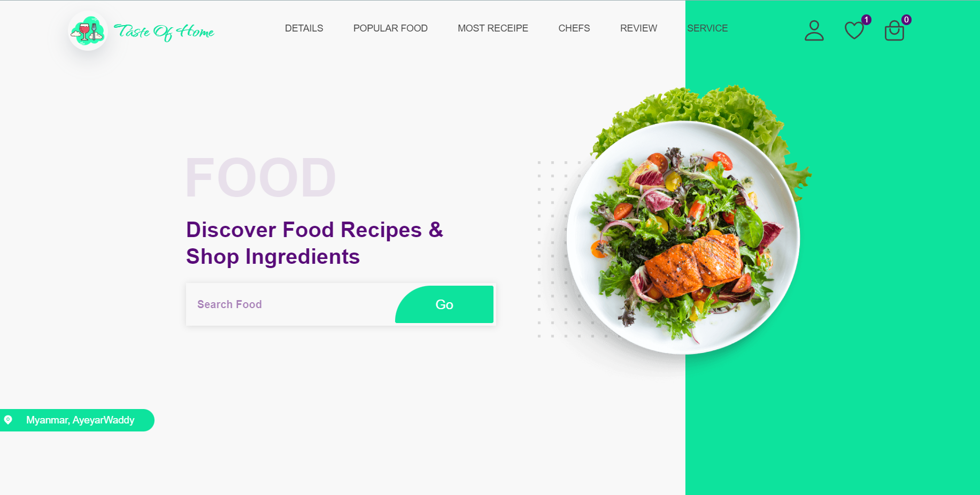
Implementation

Slide 8
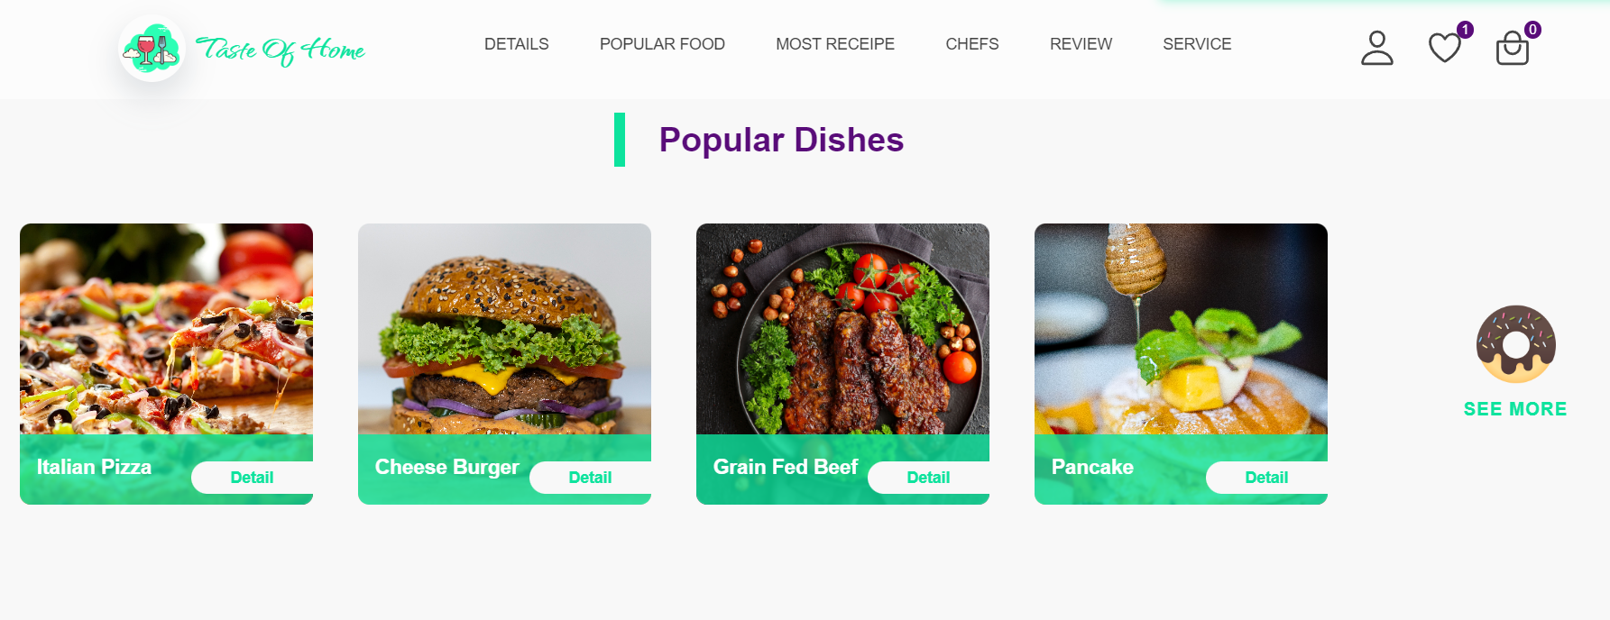

Slide 9
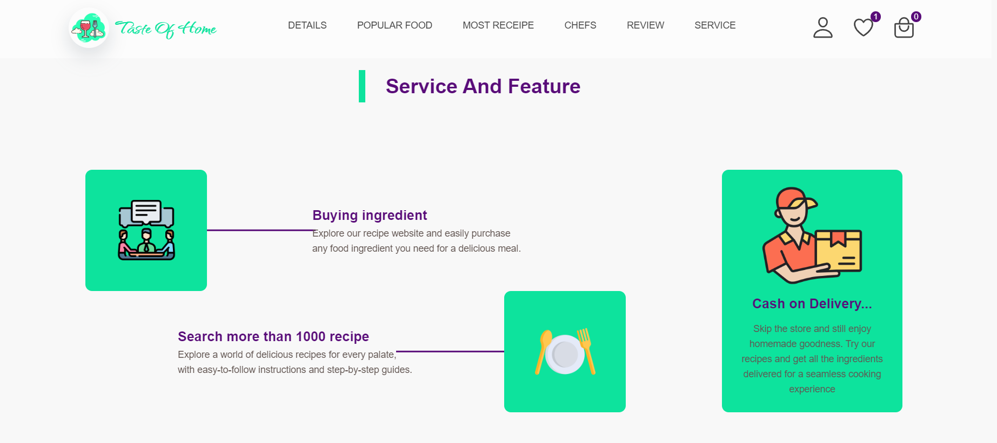

Slide 10
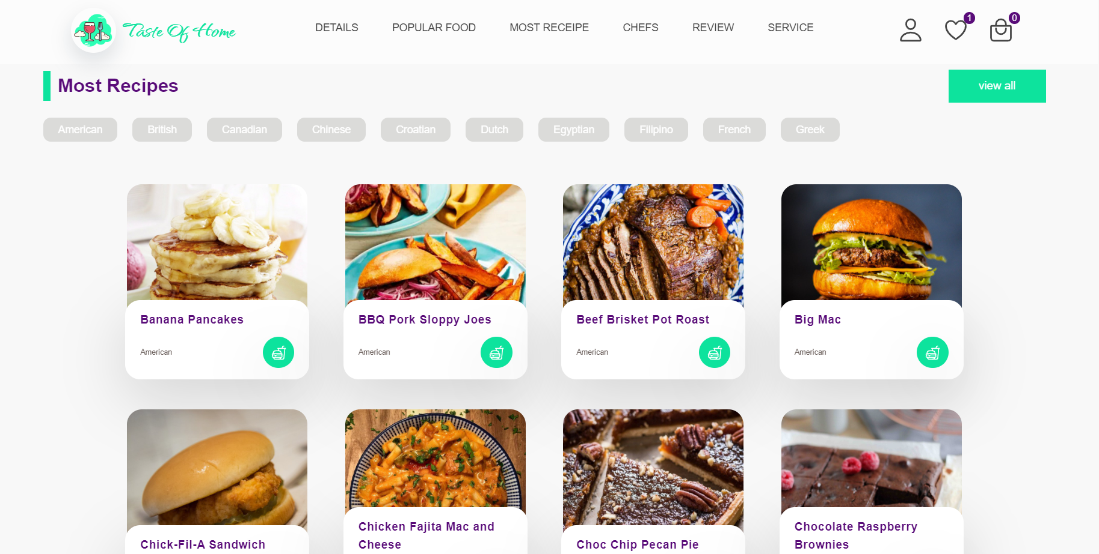

Slide 11
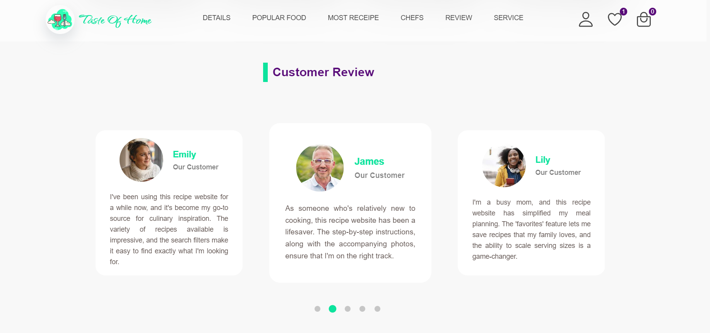

Slide 12
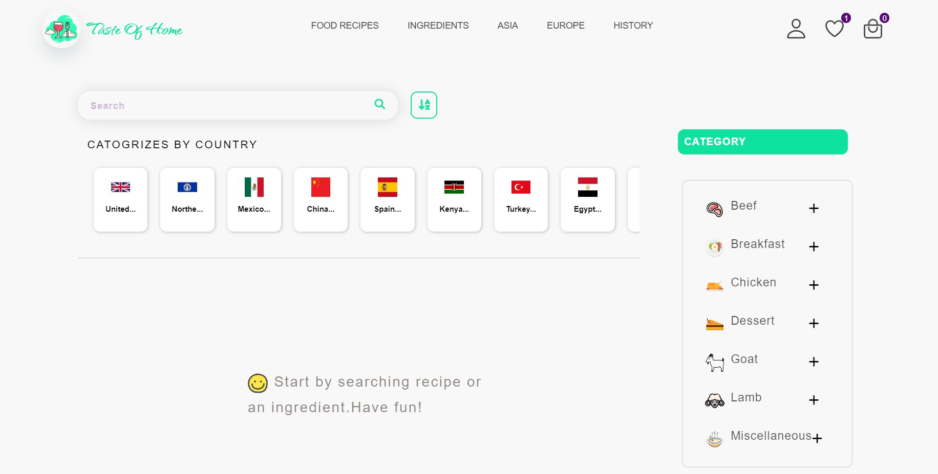

Slide 13
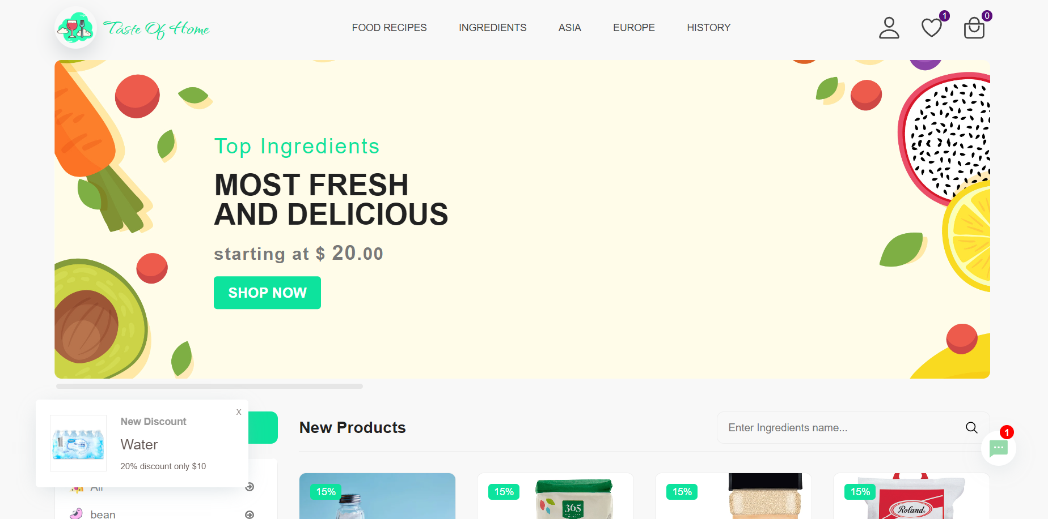

Slide 14
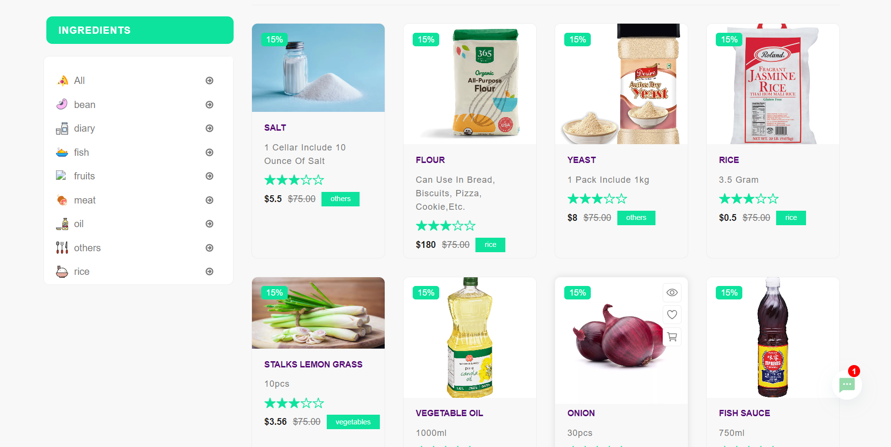

Slide 15
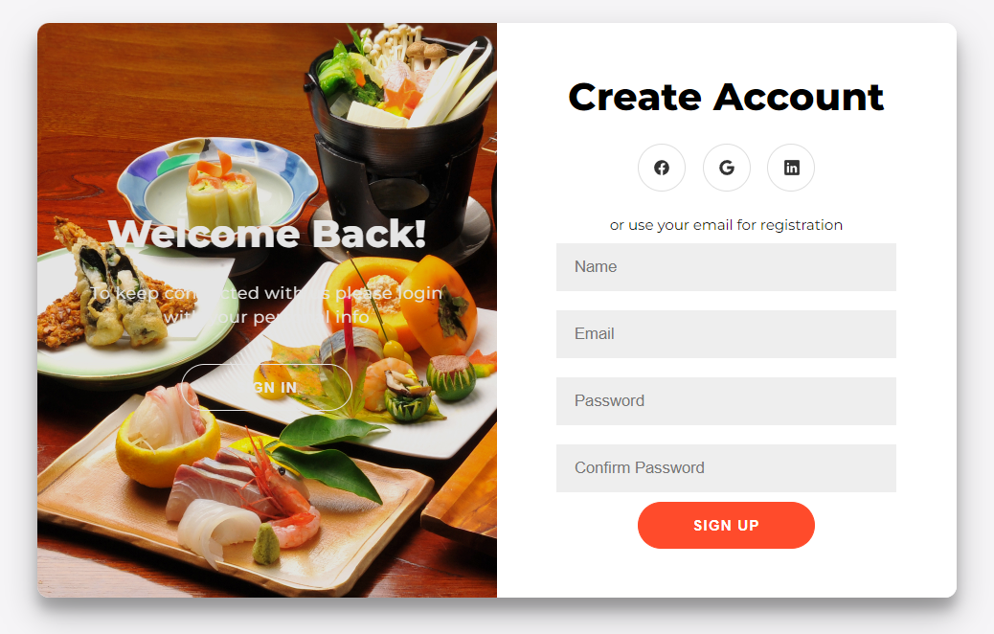

Slide 16
Conclusion
The interesting topics of many dishes are described so that people who are interested in foods can easily explore them.
This website have listed the best meals, traditional foods and their ingredients.
On this website, you can find and buy various spice ingredients.
Therefore, our website is the best foodie website for people who love food.

Slide 17





References
Bootstrap
Walmart
ion icons
scss
Mongodb

Slide 18
Thanks for watching ☺

